Slide 1
Centralized service and data access on E-Learning platforms.
Muhia J. Mwangi-SCT212-0051/2017
Peter Mwanzia-SCT212-0067/2017

Slide 2
Introduction
E-learning - utilizing electronic technologies to access educational curriculum
E-Learning has gained a lot of popularity due to increase in affordability and purchasing power of Kenyans and also due to COVID outbreak which restricted gathering.

Slide 3
A typical online class environment has many activities that have to be accommodated such as:
First the instructor has to share a link for the class.
Conduct live/online video classes.
Distribute of tutorials and resources.
Student forums, announcements.
Conducting evaluation such as CATS/Assignments.

Slide 4
Problem statement
In the recent past students have had to adopt online learning due to the COVID19 pandemic and all the tension that came with physical involvement. This change has not been very easy for most of the students because the online classes have not been as effective. The main problem is that the e-learning platforms are not centralized, consolidated and as involving as physical face-to-face classes. This has led to the rise of the following issues:
Delayed or ineffective communications on important matters.
Lack of a firm framework to encourage students to learn.
Difficulty in accessing of learning resources
Some students claim to have gotten supplementary exams because they allegedly did not send their CATs to their lecturer, which was done via email.
A high level of self-discipline is required, learners with low motivation or bad study habits may fall behind.
Absence of a learning atmosphere in e-learning systems.
The UI is not as user friendly as you would expect. For instance Kenet.

Slide 5
Objectives
The purpose of this study is to establish the effectiveness of current decentralized e-learning platforms and use UI and UX design to develop a centralized, user friendly platform. The objectives of the research include:
To study the effectiveness of current platforms in providing a firm framework to encourage students to learn.
To study how providing a dedicated communication channel for students and lecturers will affect their interest to learn and teach respectively.
Study how organised accessibility of learning resources will impact students’ productivity.
To establish how the current e-learning platforms ensure accountability.
It will be like a combination of KENET and JKUAT SODEL4 platform.

Slide 6
PROJECT JUSTIFICATION
E-learning has been around for long but most of the students got to experience it for the first time after the COVID 19 pandemic. Students have been having a hard time adjusting to online studies due to the facts stated above in the problem statement. There is need to organize and centralize the whole online learning experience to ensure effectiveness and accountability. Having access to well organised learning resources saves student efforts and time. Having a centralized centre of operation increases students’ productivity. Enabling effective e-learning environment calls for purposeful and conscientious effort towards facilitating adequate social and teaching presence as a requisite to meaningful learner engagement (Nortvig et al., 2018; Rodrigues et al., 2019).

Slide 7
How we purpose to solve the problem.
The problems stated above can be solved by creating an e-learning platform that is simple, intuitive and that consolidates all the learning activities including online classes, assessments, dedicated communication channels and that provides a virtual learning atmosphere so students feel comfortable with e-learning. We plan to achieve this by:
Using UI and UX technologies in the designs to make the platform intuitive, user friendly and keep things interesting.
User profiling to ensure accountability.
Consolidate all learning activities in our platform to ensure effective communication, resource availability and effective evaluation and avoid loss of important information.

Slide 8
LITERATURE RELEVANT TO OUR PROPOSAL
Regardless of how extraordinary the technology is in an educational institution, the readiness of E-learning execution played a large role in boosting the educational process during the COVID-19 pandemic (Ammar Y. Alqahtani and Albraa A. Rajkhan, 2020).
In a study of social issues, lecturer issues, academic issues, and generic issues, the mean for the individual items in learners’ intention to study online showed that students were not ready to study online (Emmanuel Aboagye et al., 2020).
There is lack of agreement about the critical challenges and factors that shape the successful usage of e-learning system during COVID-19 pandemic; hence, a clear gap has been identified in the knowledge on the critical challenges and factors of e-learning usage during this pandemic (Mohammed Amin Almaiah et al., 2020)

Slide 9
RESEARCH METHODS AND DESIGN.
The purpose of this research is to establish and document the challenges we face in relation to the current platforms used for our online classes and their effectiveness too. The primary research method for this project is literature review and interviewing students on their preferences and opinions. This research will review existing E-learning systems and their constraints and based on the outcome, we will improve on the concepts and ideas and come up with a better and more friendly E-learning system.

Slide 10
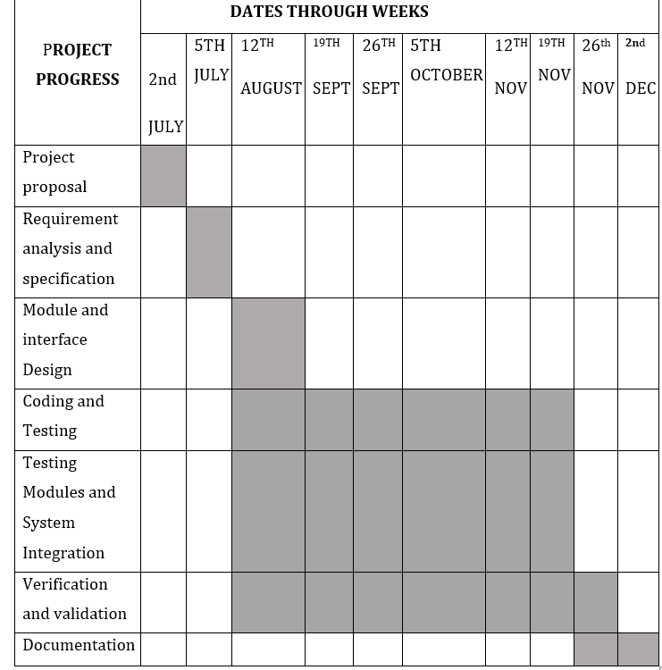
SCHEDULE

Slide 11
BUDGET
Subscriptions | 3000
Internet Access | 2000
Printing | 100

Slide 12
Conclusion.
Most University students attended face-to-face classes and are very new to this. We would like to make their experience with it as frictionless as possible. Our project will make this possible and make students’ and lecturers’ lives so much easier.

